Slide 1

Attack Detection in Water Distribution System part of SCADA MU-EGCO623 Data Mining and EGCO611 Programming Techniques for Advanced Application
10th December 2023
Sukkarin Ruensukont (G6538138)
Instructor: Asst. Prof. Tanasanee Phienthrakul, Ph.D.
Instructor: Asst. Prof. Vasin Suttichaya, Ph.D.

Slide 2

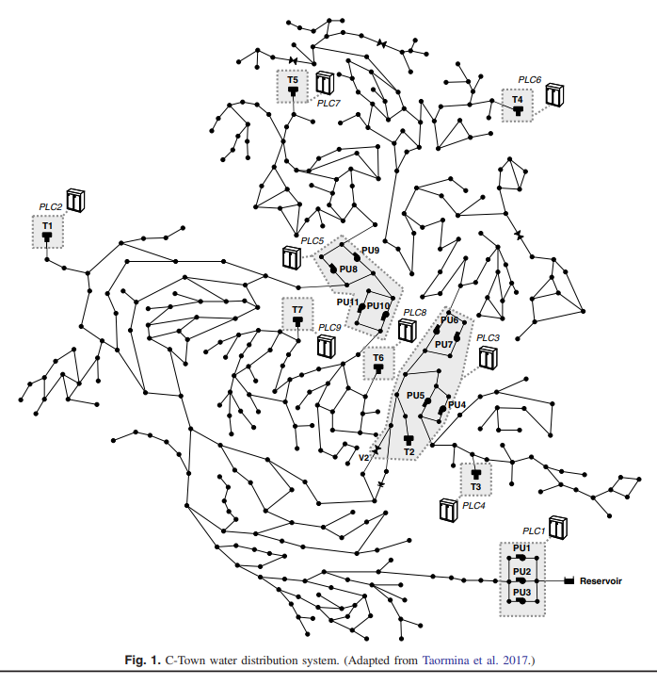
Outline
Problem and Objective
Features
negative, missing,
train_test_split,
downsampling
Select features
Methodologies: 3ML, 5 Ensembles, features selection
Bonus Track + Q & A

Slide 3

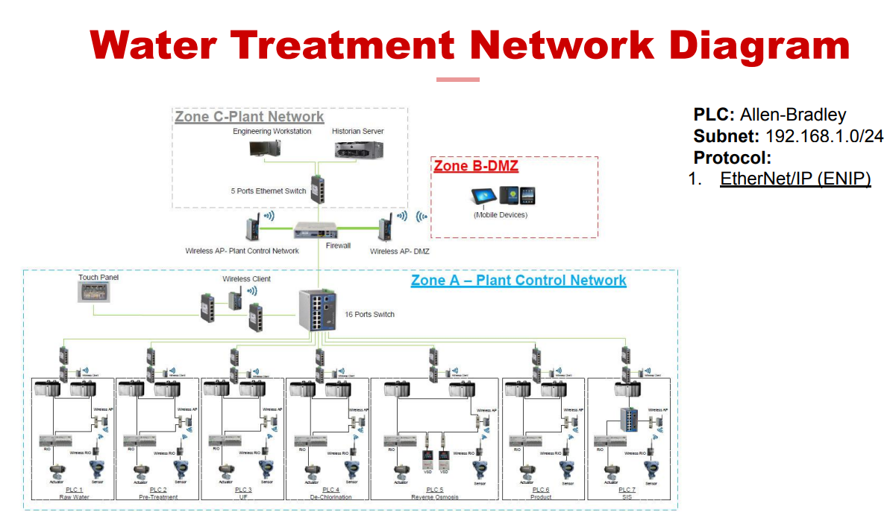






S C A D A
Supervisory Control and Data Acquisition(SCADA)
Stuxnet, Siemens PLC – Iran
Water, Electricity, GAS
Critical Infrastructure Security Showdown(CISS) 2016-2023
https://itrust.sutd.edu.sg/ciss-2023/ submit request form to get labeled data

Slide 4

DCS – Water’24
https://itrust.sutd.edu.sg/first-international-conference-on-the-design-of-cyber-secure-water-plants-dcs-water24/programme-dcs-water24/

Slide 5
BATADAL2017
Features of BATADAL
7 Tank water levels, denoted L_<tank_id>
12 Pressure for actuated valve, denoted P_<junction id>
12 flows for actuated valve, denoted F_<actuator id>
12 status for actuated valve, denoted S_<actuator id>
Total 43 features
But we mainly use WADI2019 which more complex

Slide 6
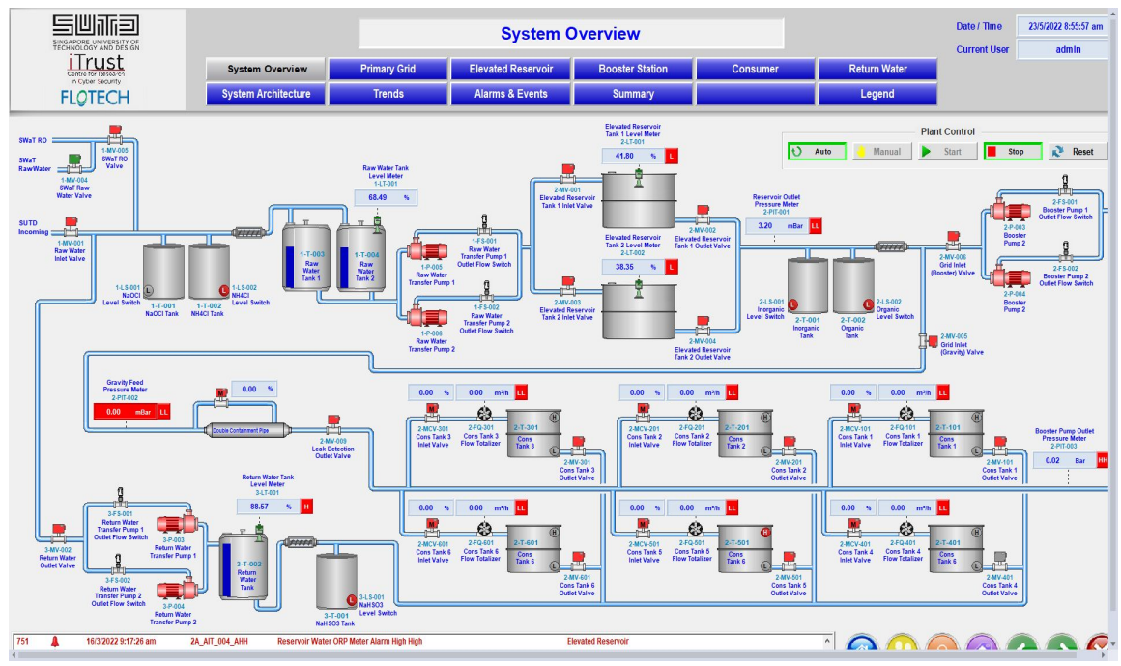
WADI2019

Slide 7
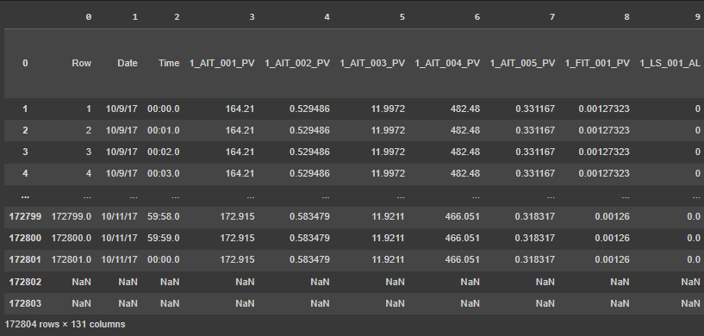
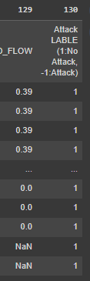
WADI2019

Slide 8
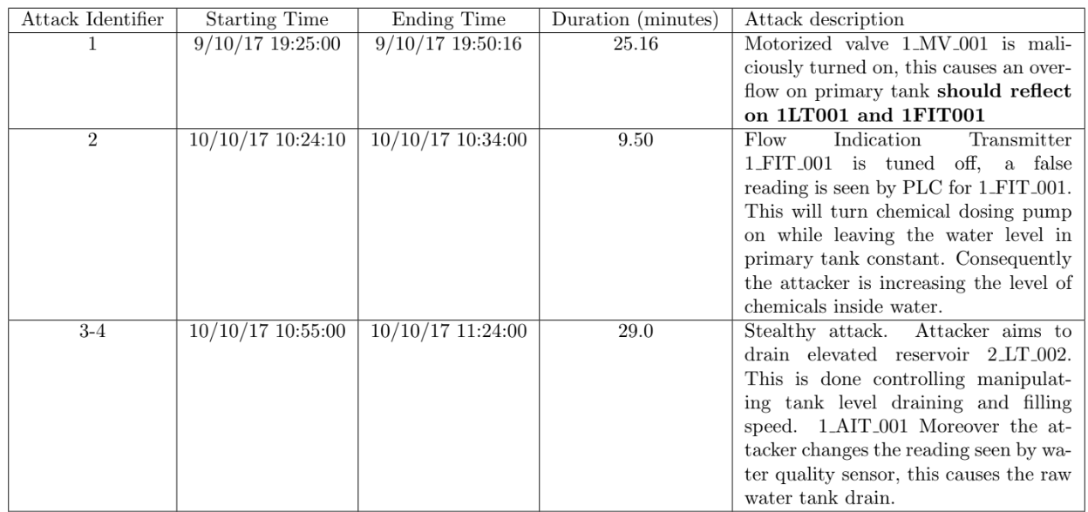
Attack on WADI2019
Overflow the tank
Change Chemical level
Overflow the tank
Pump malfunction on/off repeatedly

Slide 9
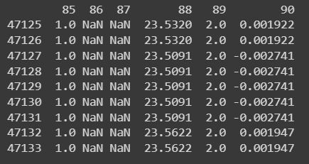
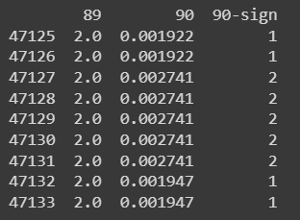
Method
Shape = 172801 row, 130 columns
Column contain both positive and negative value

Slide 10
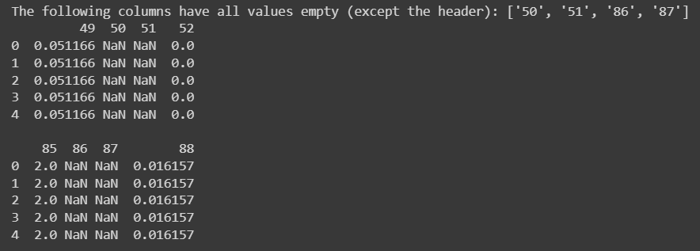
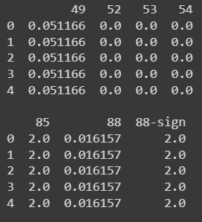
Method
Find and remove empty column

Slide 11
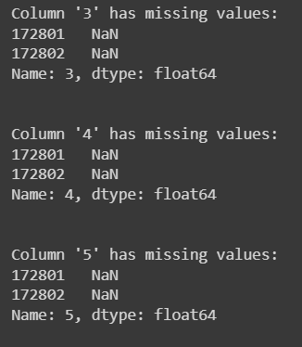
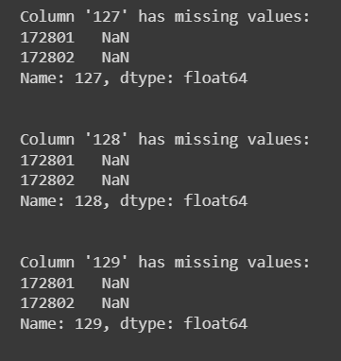
Method
Find and drop 2 rows with missing value

Slide 12
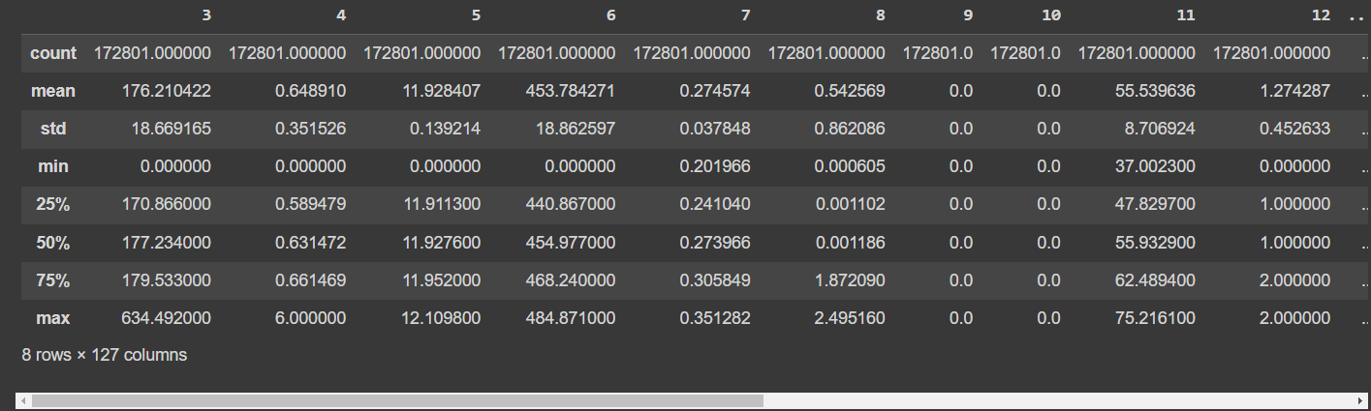
Method
Before Normalization

Slide 13

Method
After Normalization, MinMaxScaler

Slide 14
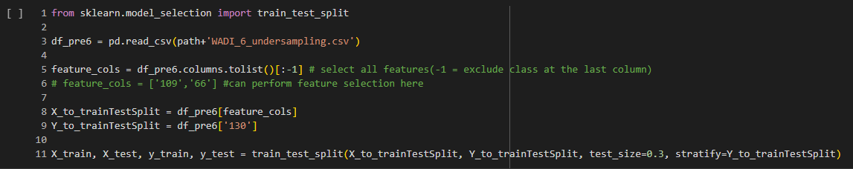
Method
Train:test = 70:30
stratify based on class(1 = No Attack, -1 = Attack )

Slide 15
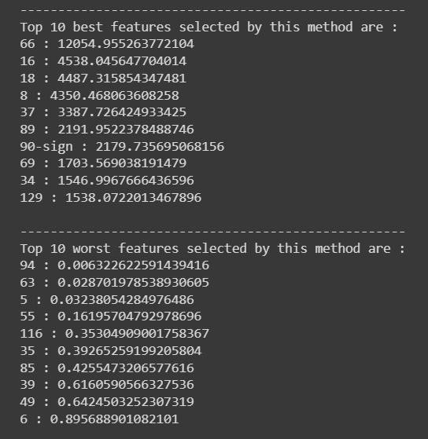
Process
Top best feature scores
Top worst feature scores
Select only feature score > 100 count = 49 from original 130 features

Slide 16
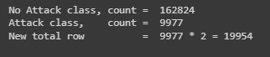
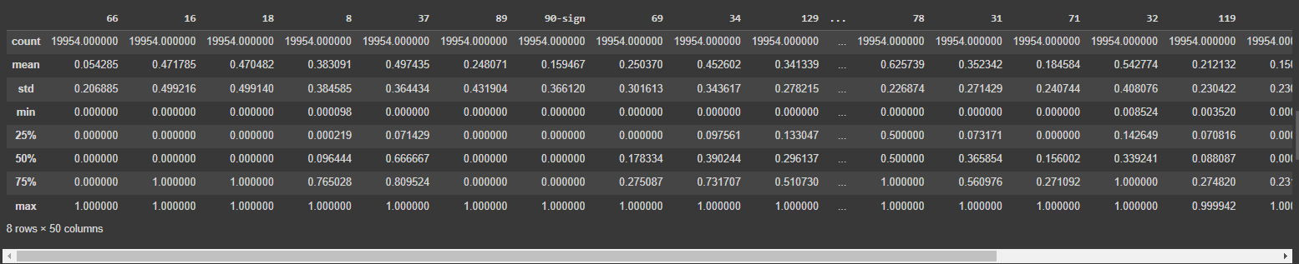
Method
Downsampling
Before Downsampling: No Attack = 162824, Attack = 9977
After Downsampling : No Attack = 9977, Attack = 9977

Slide 17
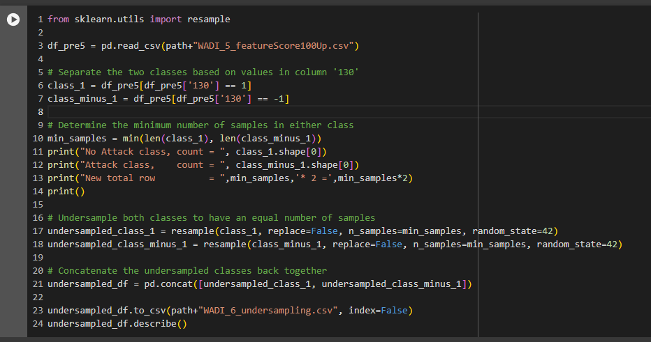
Method
replacement = False
class1 = No Attack

Slide 18
Method and post process
49 features which feature score > 100
Train model DT, KNN, RF
Ensemble 5 models
Ensemble1: Majority Votes
Ensemble2: Voting with adjusted weight, DT=2, KNN=1, RF=1
Ensemble3: Voting with adjusted weight, DT=2, KNN=2, RF=1
Ensemble4: Voting with adjusted weight, DT=4, KNN=3, RF=2
Ensemble5: Voting with adjusted weight, DT=2, KNN=1, RF=3

Slide 19
Results and Evaluation
DT vs KNN vs RF
Model | Accuracy | Precision | Recall | F1-Score
DT | 98.998 | 99.613 | 98.594 | 99.063
KNN | 98.680 | 99.077 | 98.292 | 98.679
RF | 89.276 | 90.082 | 88.349 | 89.186

Slide 20
Results and Evaluation
DT vs 5 Ensemble models
Model | Accuracy | Precision | Recall | F1-Score
DT | 98.998 | 99.613 | 98.594 | 99.063
Ensemble1 – Maj | 99.048 | 99.379 | 98.536 | 99.022
Ensemble2 – 211 | 98.931 | 99.757 | 98.205 | 98.973
Ensemble3 – 221 | 98.948 | 99.413 | 98.638 | 99.055
Ensemble4 – 432 | 98.964 | 99.379 | 96.601 | 99.007
Ensemble5 – 113 | 89.276 | 90.082 | 88.349 | 89.186

Slide 21
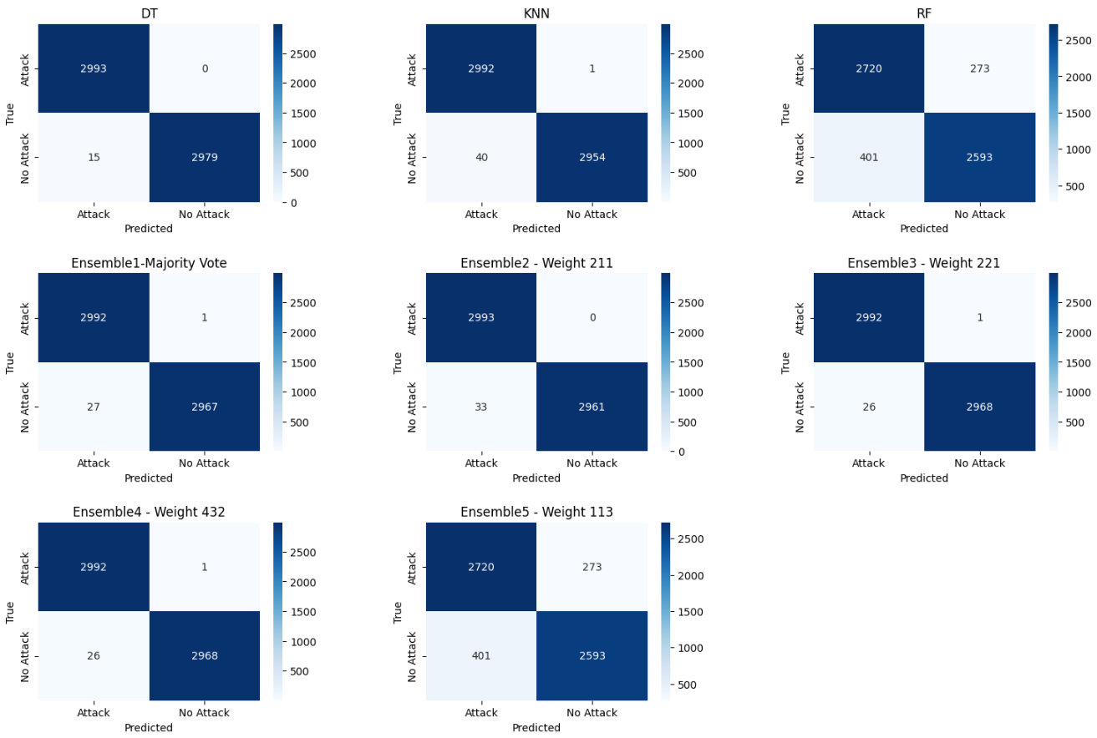
Results and Evaluation
Confusion Matrix
False Positive > False Negative
RF give high FN and high FP

Slide 22
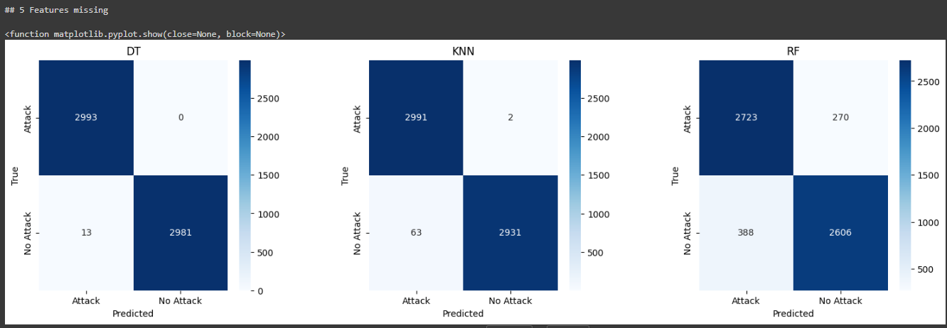
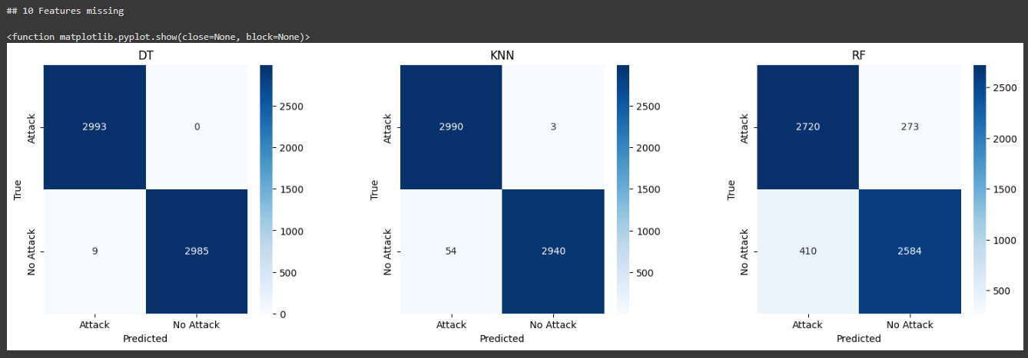
Remove some features
Remove 5 features 44 features left DT Inspect 13 FP
Remove 10 features 39 features left DT Inspect 9 FP

Slide 23

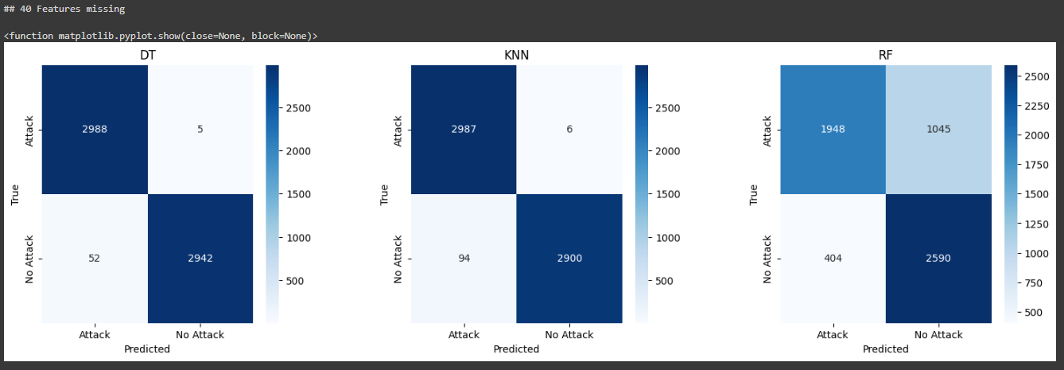
Remove some features
Remove 30 features 19 features left DT Inspect 26 FP
Remove 40 features 9 features left DT Inspect 52 FP, 5 FN

Slide 24
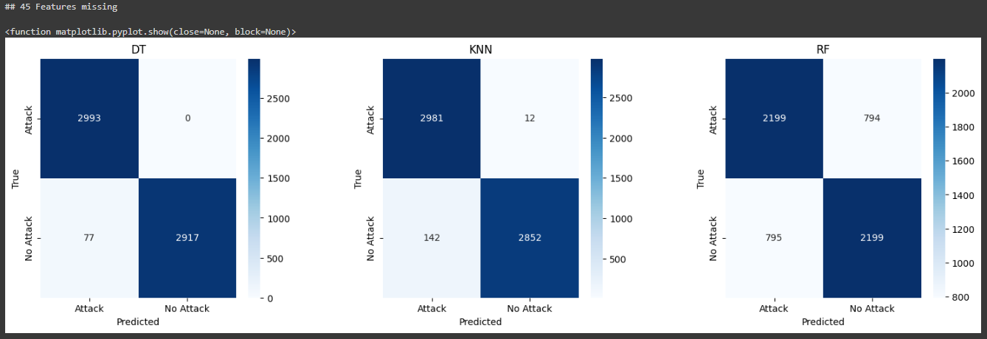
Remove some features
Remove 45 features 4 features left
DT Inspect 77 FP

Slide 25
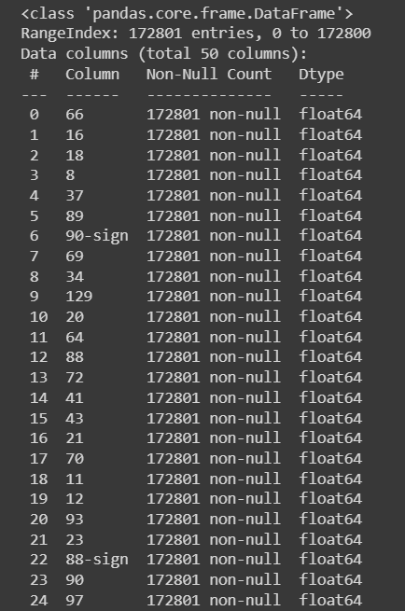
Analyze more
90-sign(6th) get higher features score than 90(23rd).
88(12th) get higher feature score than 88-sign(22nd)
This mean for feature 90, sign(positive/negative) is more significant than it’s value. But for feature 88, sign(positive/negative) is less significant than it’s value.

Slide 26
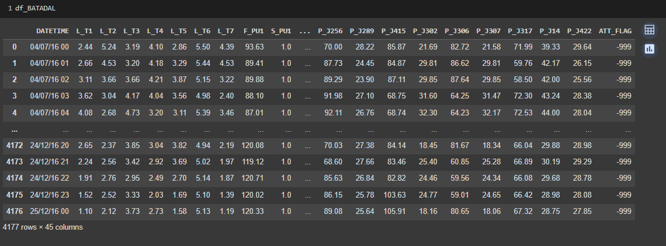
Bonus: BATADAL2017
4177 rows, 45 Features
L_<Tank name> Tank level
F_<Pump name> Pump flow
S_<Pump name> Pump status
P_<point> press at given point
‘ ATT_FLAG’ (1, -999)

Slide 27
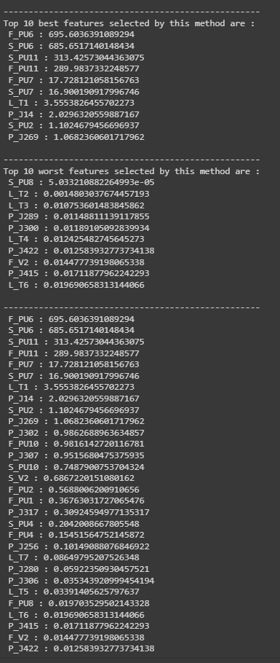
Bonus: BATADAL
4177 rows, 45 Features
L_<Tank name> Tank level
F_<Pump name> Pump flow
S_<Pump name> Pump status
P_<point> press at given point
‘ ATT_FLAG’ (1, -999)

Slide 28
Conclusion
Model | Accuracy | Precision | Recall | F1-Score
DT | 98.998 | 99.613 | 98.594 | 99.063
KNN | 98.680 | 99.077 | 98.292 | 98.679
RF | 89.276 | 90.082 | 88.349 | 89.186
Model | Accuracy | Precision | Recall | F1-Score
DT | 98.998 | 99.613 | 98.594 | 99.063
Ensemble1 – AVG | 99.048 | 99.379 | 98.536 | 99.022
Ensemble2 – 211 | 98.931 | 99.757 | 98.205 | 98.973
Ensemble3 – 221 | 98.948 | 99.413 | 98.638 | 99.055
Ensemble4 – 432 | 98.964 | 99.379 | 96.601 | 99.007
Ensemble5 – 113 | 89.276 | 90.082 | 88.349 | 89.186

Slide 29
Conclusion
Decision tree model give highest recall and F1-score
If target to reduce False Positive, consider Ensemble model weight DT=2, KNN=1, RF=1
Some features, such as ‘90’ sign is more significant than it’s numerical value
Some features, such as ’88’ it’s numerical value is more significant than it’s sign
Newer Water Distribution System(WADI2019) is tolerant to removing top features and still giving high recall and F1-score.
BATADAL2017 show that features on Pump flow and Pump status are the most 2 important features to determines the attack.

Slide 30
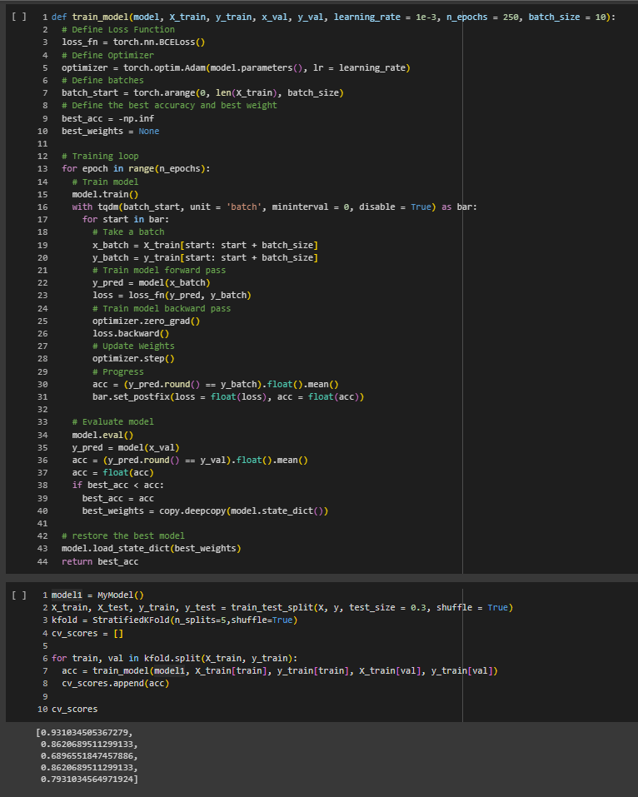
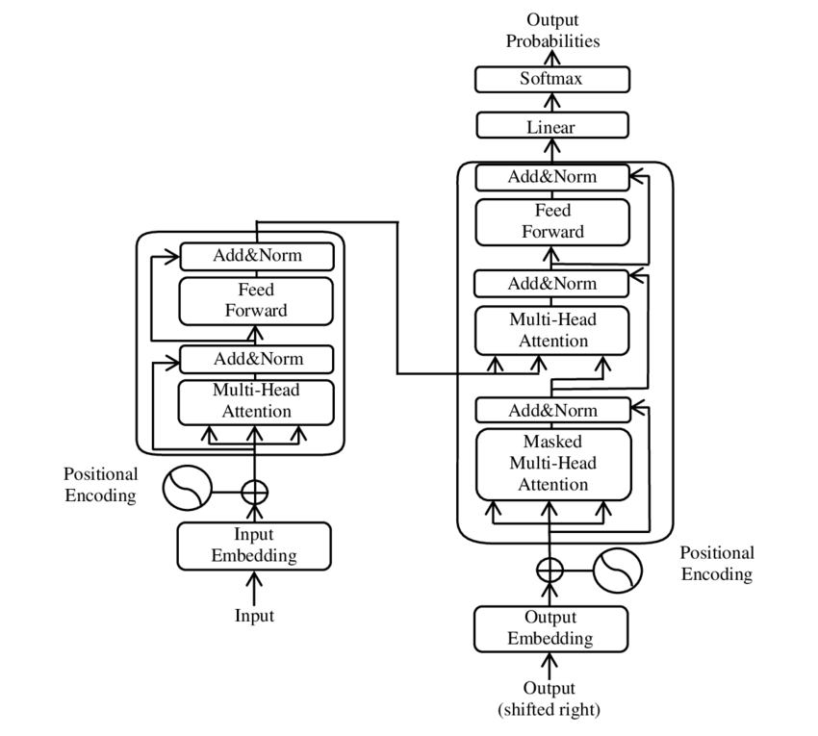
Future Improvement
Given features with low score to Deep Learning Model since we have 172,801 row. Already Prepare Deep Learning Model(Mine, Rock) from Aj.Wasin. Next step input dataset.
Train model on newer dataset when labeled dataset available
Train model on Electricity system, Gas system
Use transformer(Improve from LSTM) to train model
transformer
adjust input’s effect to output
linear? Tensorflow
use sigmoid
BCELoss()

Slide 31

Q&A

Slide 32
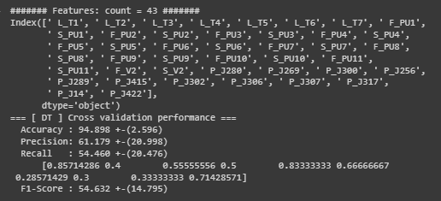
BATADAL2017
[DT] cross validation
Accuracy 94.898%
Precision 61.179%
Recall 54.460%
F1-Score 54.632%

Slide 33
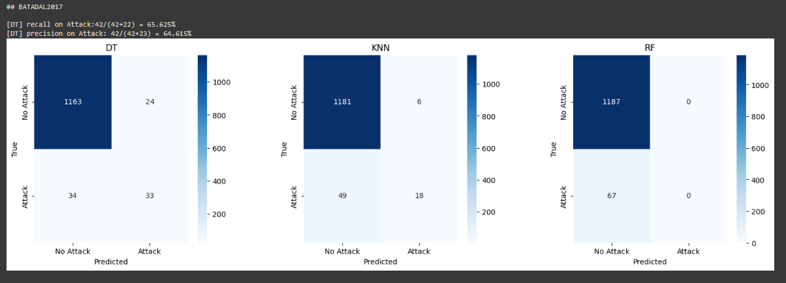
BATADAL2017
[DT] focus on Attack
Accuracy 95.375%
Precision 64.625%
Recall 65.625%
F1-Scorre 65.121%

Slide 34
WADI2019

Slide 35
WADI2019

Slide 36
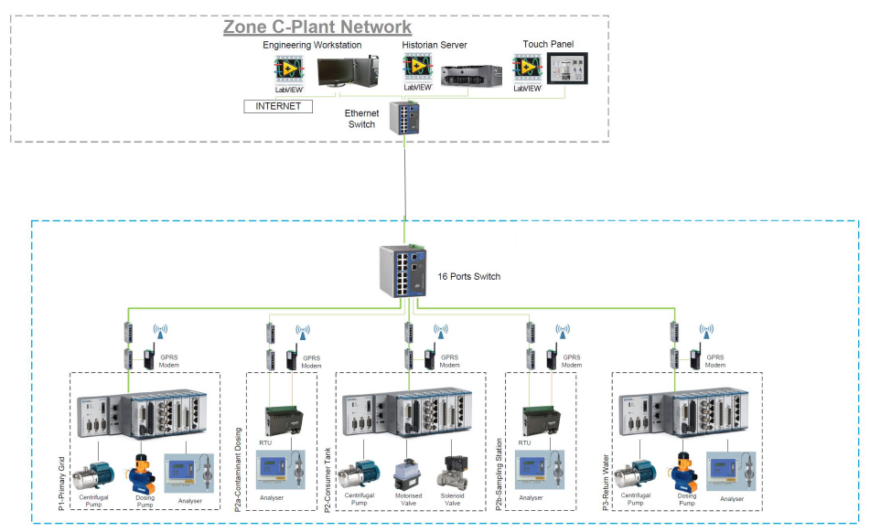
WADI2019

Slide 37
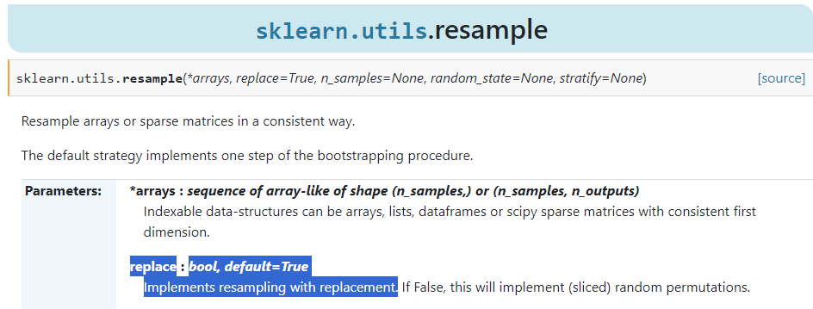
Method
replacement = False
resample without replacement
default = True

